Slide 1
Foreign workers with National Health Insurance who are eligible to receive a COVID-19 vaccination can register online and book a time and place to receive a vaccine shot
Important Notice
2
The 1922 Hotline will contact those who are eligible to be vaccinated by text message
1
3
4
Registration3
Booking a Vaccine Shot
Receiving a Vaccine Shot
1
Source: Central Epidemic Command Center

Slide 2
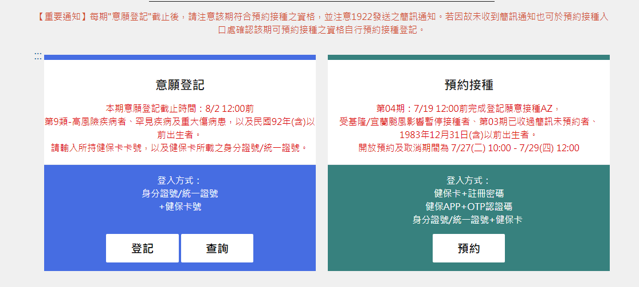
How to Use the Vaccination Registration and Booking System
Government-funded COVID-19 Vaccination Booking Platform
https://1922.gov.tw/vas/
2
Source: Central Epidemic Command Center

Slide 3
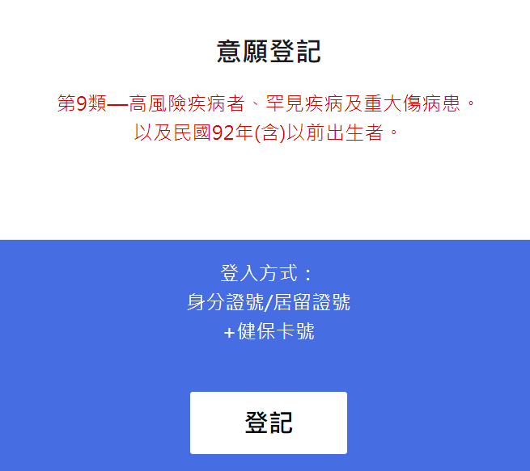
Step 1 – Click Registration
1
Registration
Registration
9th category on the COVID-19 vaccination priority list - Individuals who suffer from conditions that put them at a higher risk of serious illness from COVID-19; those who suffer from rare or serious illnesses or injuries.
Born before 2003 (inclusive)
How to sign up
Alien Resident Certificate No. + Health Card No.
“Register”
1
2
1
2
3
3
4
4
5
5
3
Source: Central Epidemic Command Center

Slide 4
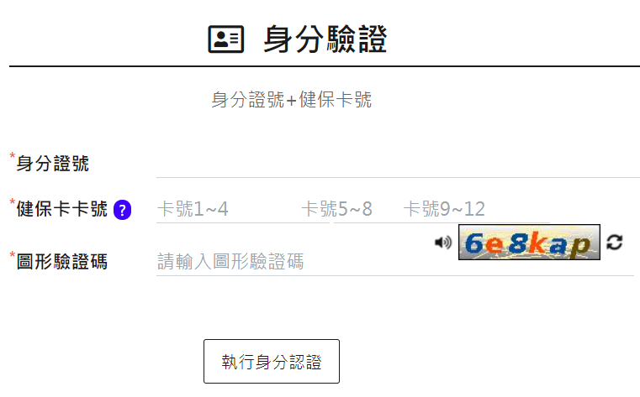
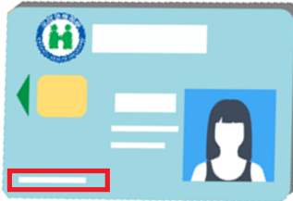
Step 2 – Enter Personal Data
Authentication data
Alien Resident Certificate No. + National Health Insurance Card No.
Alien Resident Certificate No.
National Health Insurance Card No.
There is a 16 digit number in the bottom left hand corner on the front of the card
CAPTCHA
Identity authentication
1
1
2
2
3
3
4
4
5
6
5
6
4
Source: Central Epidemic Command Center

Slide 5
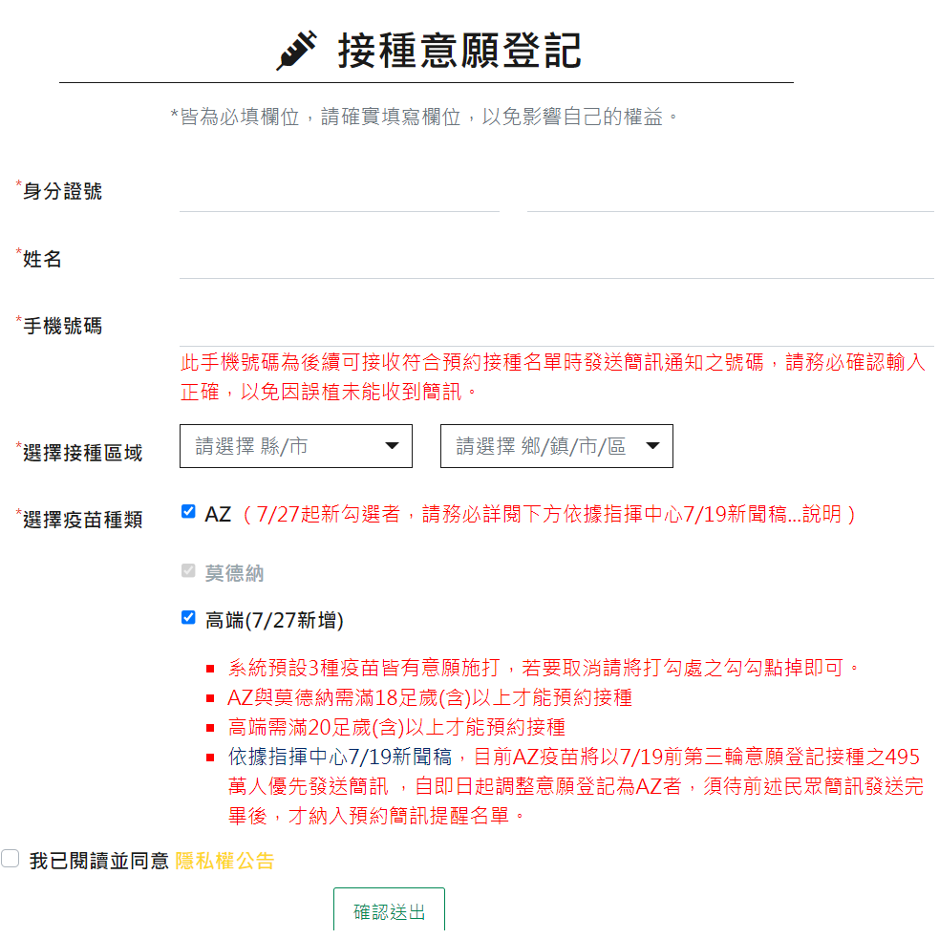
Step 3 – Select a Vaccination Area and Vaccine Brand
1
Vaccination Registration
All these rows must be filled out, please do so accurately to avoid adversely impacting your rights
Alien Resident Certificate No.
Name
Cell Phone No.
Select a vaccination area
County/City, Administrative area
Select a vaccine brand
AZ (AstraZeneca)
Moderna
Medigen
I have read and agree with the privacy announcement
Confirm
1
2
2
3
3
4
4
5
5
6
6
7
7
8
9
8
9
5
Source: Central Epidemic Command Center

Slide 6
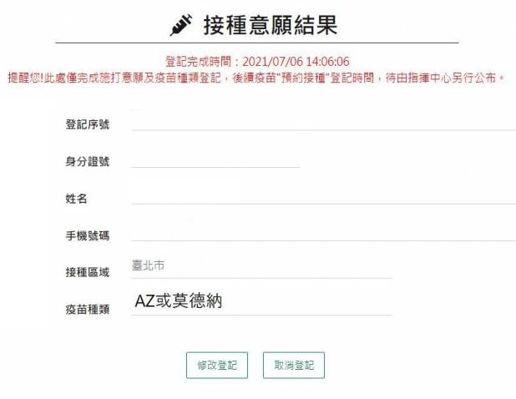
Step 4 – Successful Registration
Vaccination registration confirmed details
Time of registration
Please note that this registration indicates willingness to receive a vaccination and preferred vaccine brand. Vaccine shot appointment times will be announced by the CECC at a later date
Registration No.
Alien Residence Certificate No.
Name
Cell Phone No.
Vaccination area
Vaccine brand
Change registration
If the data provided is inaccurate please repeat the registration process
Cancel registration
If you change your mind and decide not to get vaccinated then please cancel your registration
1
2
1
2
3
3
4
4
5
5
6
7
6
8
7
9
8
10
9
9
10
6
資料來源:中央流行疫情指揮中心

Slide 7
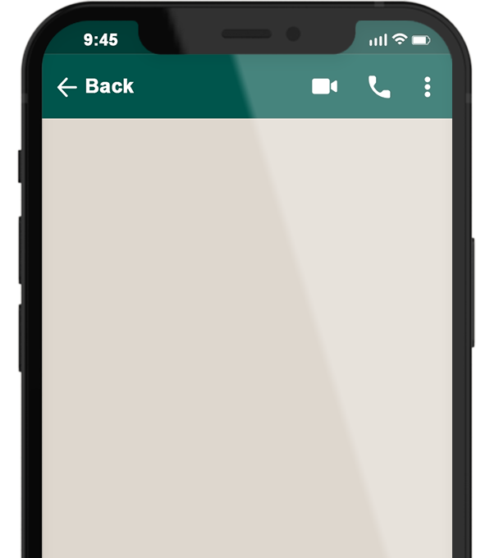
2
The 1922 Hotline will send a text notification to those who are eligible to receive a vaccine shot
Online Booking
Go to the 1922.gov.tw website and select the location where you would like to receive the vaccine shot and preferred brand of vaccine
1922
COVID-19公費疫苗登記序號： 0000000000 ，請於O月O日-O月O日選擇您所登記接種地點： OOO 之接種站進行預約接種登記。
In Person Booking
National Health Insurance cards can be used to select a vaccination location and time period using appointment booking machines at convenience stores, pharmacies or health centers
7
Source: Central Epidemic Command Center

Slide 8
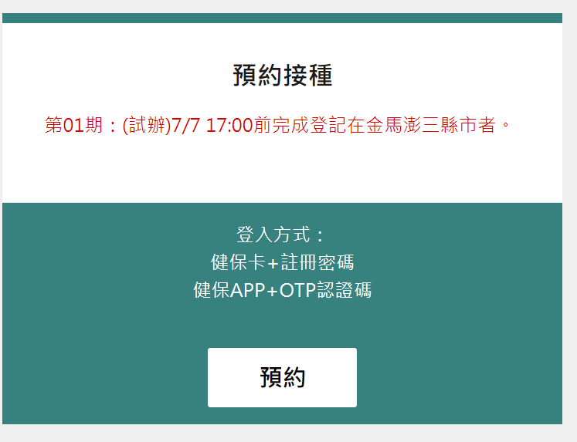
Step 1 – Click Booking a Vaccine Shot
3
Booking a Vaccine Shot
https://1922.gov.tw/vas/
1
2
Booking a vaccine shot
Time
How to sign in
National Health Insurance card No. + Registration password
Health Insurance APP + OTP authentication code
Click “Book Vaccine Shot”
1
2
3
3
4
4
8
資料來源:中央流行疫情指揮中心

Slide 9
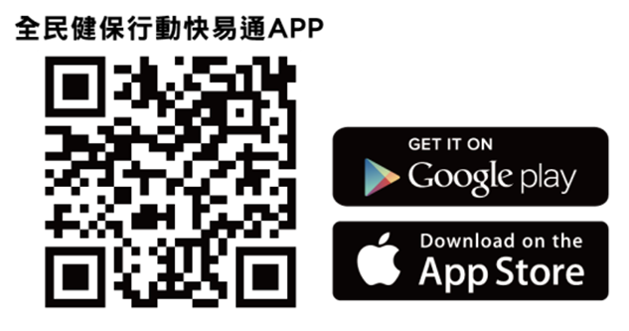
Step 2 – Select Vaccine Shot Booking Method
You will need a National Health Insurance card and a card reader
1
1
2
National Health Insurance card + Registration password
Health Insurance APP + OTP authentication code
Select “Book Vaccine Shot”
2
3
3
3
9
Source: Central Epidemic Command Center

Slide 10
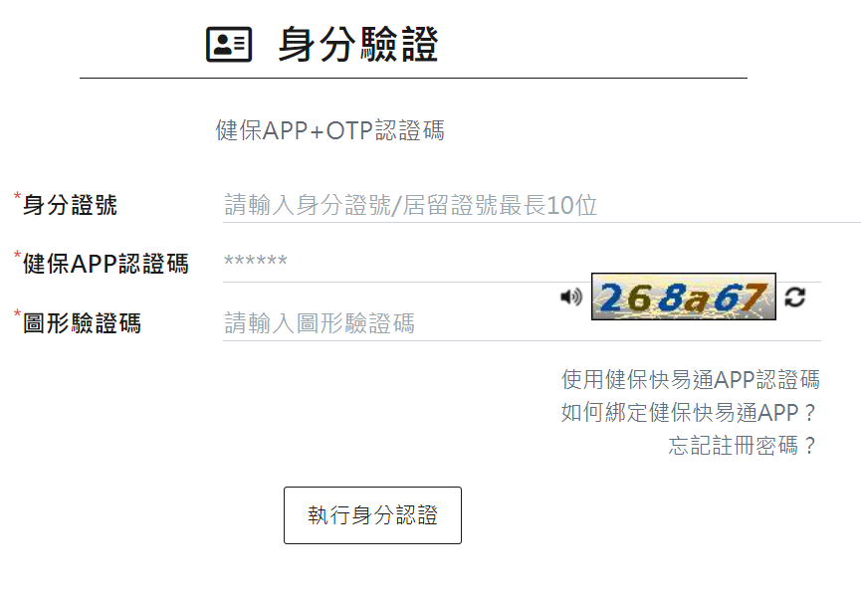
Step 3 – Completing Identity Verification
Using health Insurance APP + OTP authentication
1
Please input your Alien Resident Certificate No.
Health Insurance APP authentication code
CAPTCHA
“Identity Verification”
1
2
2
3
2
3
4
After completing the identity verification process select a preferred location and time to receive your vaccine shot
3
4
10
資料來源:中央流行疫情指揮中心

Slide 11
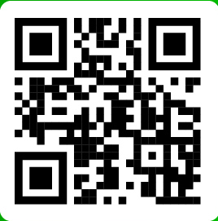
4
Receiving a Vaccine Shot
Be sure to arrive on time for your vaccine shot
Those who miss a vaccination appointment will have to wait until the next time the system accepts bookings to make a new appointment
If you encounter any difficulties making a vaccine appointment call the 1955 Hotline or seek assistance from the 1955 E-Line text customer service
LINE
1955 E-Line
11

